Slide 1
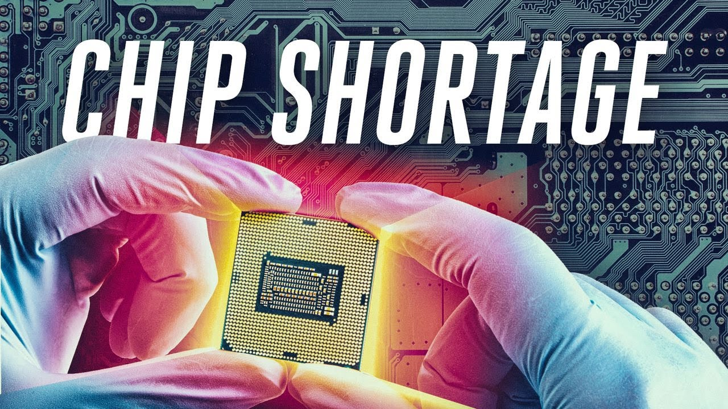
Presented by
Joseph Acayo Arias
Bat Baasan
George Mason University
Spring 2022

Slide 2
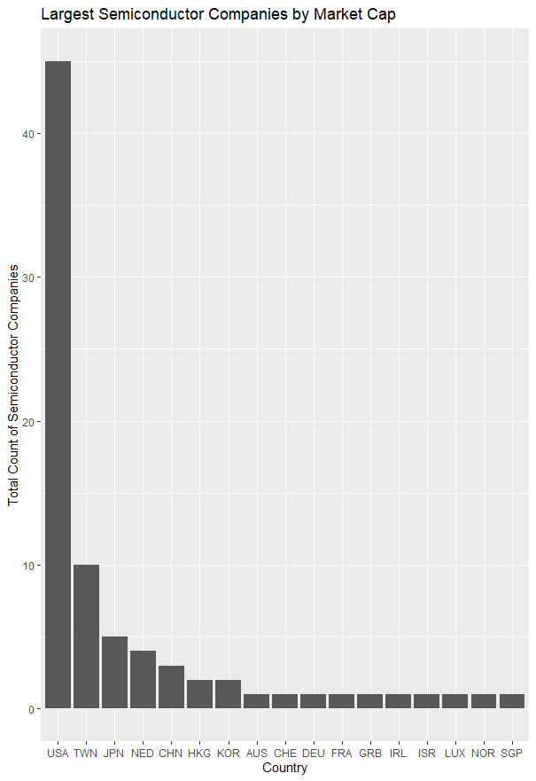
Market Cap: Largest Semiconductor Companies
Source: Largest semiconductor companies by market cap (companiesmarketcap.com)

